Slide 1
VE281 Data Structures and Algorithms
Hashing: Basics and Hash Function
Learning Objectives:
Know the purpose of hashing
Understand the collision problem
Know how to design a good hash function

Slide 2
Outline
Review of Dictionary
Hashing Basics
Hash Function

Slide 3
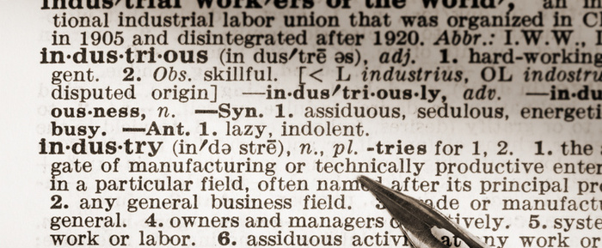
Dictionary
How do you use a dictionary?
Look up a “word” and find its meaning.
We also have an abstract data type called dictionary.
It is a collection of pairs, each containing a key and an value (key, value)
Important: Different pairs have different keys.

Slide 4
Dictionary
Key space is usually more regular/structured than value space, so easier to search.
Dictionary is optimized to quickly add (key, value) pair and retrieve value by key.

Slide 5
Methods
Value find(Key k): Return the value whose key is k. Return Null if none.
void insert(Key k, Value v): Insert a pair (k, v) into the dictionary. If the pair with key as k already exists, update its value.
Value remove(Key k): Remove the pair with key as k from the dictionary and return its value. Return Null if none.

Slide 6
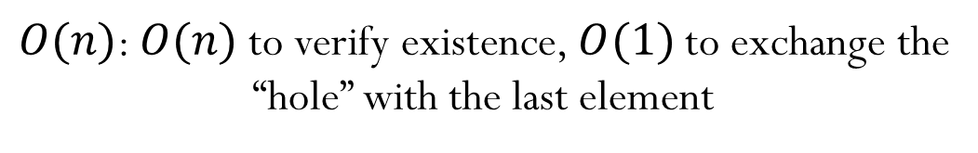

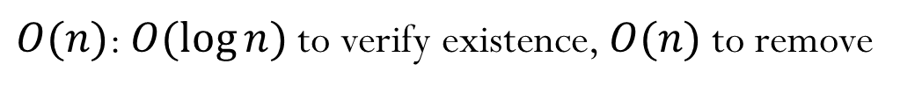
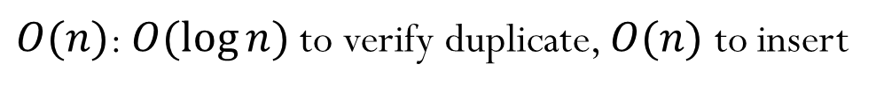
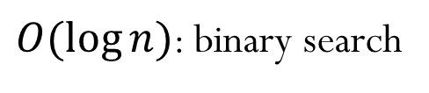
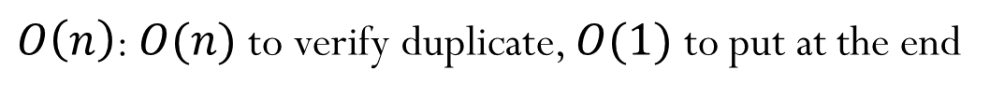
Runtime for Array Implementation
Unsorted array
find()
insert()
remove()
Sorted array
find()
insert()
remove()
Pair Array[MAXSIZE]:
a
b
c
d
$$O(n)$$
$O\left(n\right)$: $O(n)$ to verify duplicate, $O(1)$ to put at the end
$O(n)$: $O(n)$ to verify existence, $O(1)$ to exchange the “hole” with the last element
$O(\log{n})$: binary search
$O(n)$: $O(\log{n})$ to verify duplicate, $O(n)$ to insert
$O(n)$: $O(\log{n})$ to verify existence, $O(n)$ to remove
Can we do find, insert, and remove in $O(1)$ time?
Notes:
Let’s consider array-based implementation and its runtime.
It is like IntSet ADT.

Slide 7
Outline
Review of Dictionary
Hashing Basics
Hash Function

Slide 8
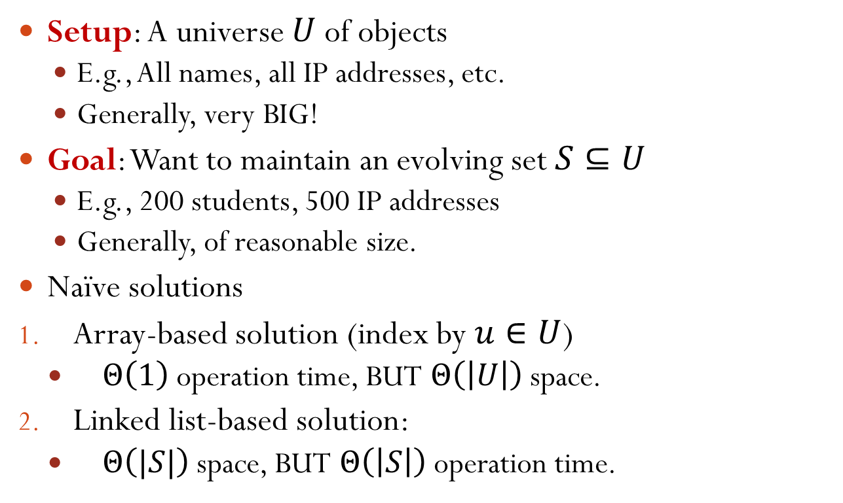
Hashing: High-Level Idea
Setup: A universe $U$ of objects
E.g., All names, all IP addresses, etc.
Generally, very BIG!
Goal: Want to maintain an evolving set $S⊆U$
E.g., 200 students, 500 IP addresses
Generally, of reasonable size.
Naïve solutions
Array-based solution (index by $u∈U$)
$Θ\left(1\right)$ operation time, BUT $Θ\left(\left|U\right|\right)$ space.
Linked list-based solution:
$Θ\left(|S|\right)$ space, BUT $Θ\left(\left|S\right|\right)$ operation time.
Can we get the best of both solutions?
Notes:
How many names do we have? Suppose it is normal to have a name of eight characters. 26^3 + 26^4 + ... + 26^8 > 26^8 = 209 billion
How many IP addresses do we have? 256^4 = 2^32 = 4.3 billion
For the solutions: consider the example of IP address

Slide 9
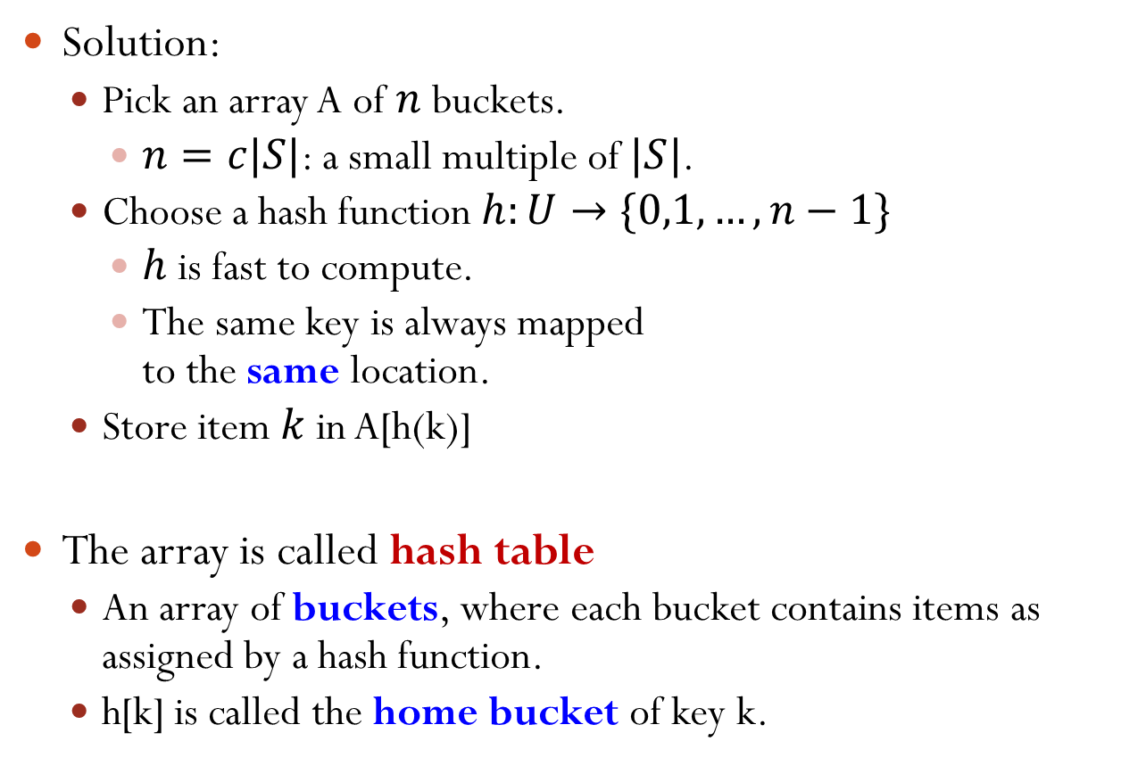
Hashing: High-Level Idea
Solution:
Pick an array A of $n$ buckets.
$n=c|S|$: a small multiple of $|S|$.
Choose a hash function $h:U→\{0,1,…,n−1\}$
$h$ is fast to compute.
The same key is always mapped to the same location.
Store item $k$ in A[h(k)]
The array is called hash table
An array of buckets, where each bucket contains items as assigned by a hash function.
h[k] is called the home bucket of key k.
$$U$$
0
1
$$⋮$$
$$n−1$$
Notes:
insert() and find() are both directed to the same location in O(1) time.

Slide 10
Hashing Example
Pairs are: (22,a), (33,b), (3,c), (73,d), (85,e)
Hash table is A[0:7] and table size is M = 8
Hash function is h[key] = key/11
Every item with key is stored in the bucket A[h(key)]
(3,c)
(22,a)
(33,b)
(73,d)
(85,e)
[0]
[1]
[2]
[3]
[4]
[5]
[6]
[7]
Question: What is the time complexity for find(), insert(), and remove()?
O(1)
Achieves both fast runtime and efficient memory usage

Slide 11
What Can Go Wrong?
Where does (35, g) go?
Problem: The home bucket for (35, g) is already occupied!
This is a “collision”.
(3,c)
(22,a)
(33,b)
(73,d)
(85,e)
[0]
[1]
[2]
[3]
[4]
[5]
[6]
[7]
Notes:
Collision is inevitable: It is due to pigeonhole principle. If we insert more keys than the number of buckets, there is definitely a collision.

Slide 12
Collision and Collision Resolution
Collision occurs when the hash function maps two or more items—all having different search keys—into the same bucket.
What to do when there is a collision?
Collision-resolution scheme: assigns distinct locations in the hash table to items involved in a collision.
Two major schemes:
Separate chaining
Open addressing

Slide 13

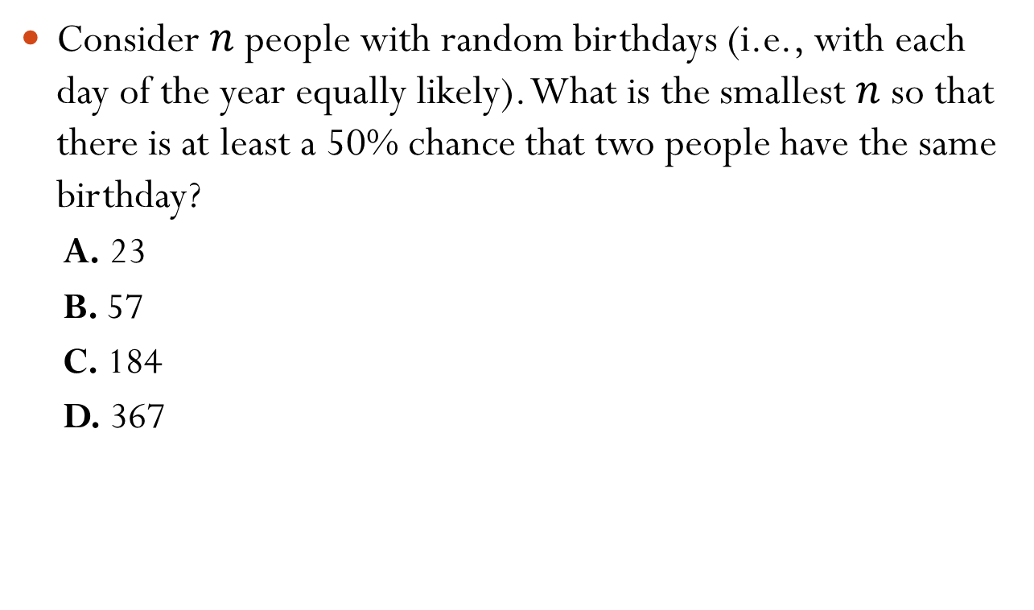
Insight of Collision: Birthday Problem
Consider $n$ people with random birthdays (i.e., with each day of the year equally likely). What is the smallest $n$ so that there is at least a 50% chance that two people have the same birthday?
A. 23
B. 57
C. 184
D. 367
Collision is inevitable!
Notes:
birthday paradox

Slide 14
Hash Table Issues
Choice of the hash function.
Collision resolution scheme.
Size of the hash table and rehashing.

Slide 15
Outline
Review of Dictionary
Hashing Basics
Hash Function

Slide 16
Hash Function Design Criteria
Must compute a bucket for every key in the universe.
Must compute the same bucket for the same key.
Should be easy and quick to compute.
Minimizes collision
Spread keys out evenly in hash table
Gold standard: completely random hashing
The probability that a randomly selected key has bucket $i$ as its home bucket is $1/n$, $0≤i<n$.
Completely random hashing minimizes the likelihood of an collision when keys are selected at random.
However, completely random hashing is infeasible due to the need to remember the random bucket.
The hardest criterion
Notes:
Why minimize? If it is not completely random, then you may collide with a probability > 1/n.
We need to remember the random home bucket for every possible key, which requires a large storage

Slide 17
Bad Hash Functions
Example: keys = phone number in China (11 digits)
$\left|U\right|={10}^{11}$
Terrible hash function: $h(key)$ = first 3 digits of $key$, i.e., area code
The keys are not spread out evenly. Buckets 010, 021 may have a lot of keys mapped to them, while some buckets have no keys.
Mediocre hash function: $h(key)$ = last 3 digits of $key$.
Still vulnerable to patterns in last 3 digits.

Slide 18
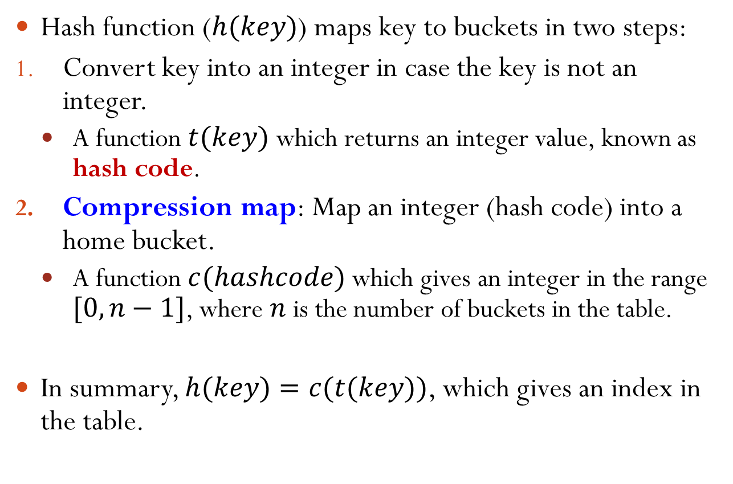
Hash Functions
Hash function ($h(key)$) maps key to buckets in two steps:
Convert key into an integer in case the key is not an integer.
A function $t(key)$ which returns an integer value, known as hash code.
Compression map: Map an integer (hash code) into a home bucket.
A function $c(hashcode)$ which gives an integer in the range $[0, n−1]$, where $n$ is the number of buckets in the table.
In summary, $h(key)=c(t(key))$, which gives an index in the table.

Slide 19
Map Non-integers into Hash Code
String: use the ASCII (or UTF-8) encoding of each char and then perform arithmetic on them.
Floating-point number: treat it as a string of bits.
Images, (viral) code snippets, (malicious) Web site URLs: in general, treat the representation as a bit-string, using all of it or extracting parts of it (i.e., www.sjtu.edu.cn).

Slide 20
Strings to Integers
Simple scheme: adds up all the ASCII codes for all the chars in the string.
Example: t(“He”) = 72 + 101 = 173.
Not good. Why?
Consider English words “post”, “pots”, “spot”, “stop”, “tops”.

Slide 21
Strings to Integers
A better strategy: Polynomial hash code taking positional info into account.
$$t\left(s[]\right)=s\left[0\right]a^{k−1}+s\left[1\right]a^{k−2}+⋯+s\left[k−2\right]a+s[k−1]$$
where $a$ is a constant.
If $a=33$, the hash codes for “post” and “stop” are
$$t\left(\text{post}\right)=112∙{33}^{3}+111∙{33}^{2}+115∙33+116=4149734$$
$$t\left(\text{stop}\right)=115∙{33}^{3}+116∙{33}^{2}+111∙33+112=4262854$$

Slide 22
Strings to Integers
$$t\left(s[]\right)=s\left[0\right]a^{k−1}+s\left[1\right]a^{k−2}+⋯+s\left[k−2\right]a+s[k−1]$$
Good choice of $a$ for English words: 31, 33, 37, 39, 41
What does it mean for $a$ to be a good choice? Why are these particular values good?
Answer: according to statistics on 50,000 English words, each of these constants will produce less than 7 collisions.
In Java, its string class has a built-in hashCode() function. It takes $a=31$. Why?
Multiplication by 31 can be replaced by a shift and a subtraction for better performance: 31*i == (i << 5) - i
Hash function criteria: Should be easy and quick to compute.

Slide 23
Compression Map
Map an integer (hash code) into a home bucket.
The most common method is by modulo arithmetic.
homeBucket = c(hashcode) = hashcode % n where $n$ is the number of buckets in the hash table.
Example: Pairs are (22,a), (33,b), (3,c), (55,d), (79,e). Hash table size is 7.
(22,a)
(79,e)
(3,c)
(33,b)
(55,d)
[0]
[1]
[2]
[3]
[4]
[5]
[6]

Slide 24
Hashing by Modulo
In practice, keys of an application tend to have a specific pattern
For example, memory address in computer is multiple of 4.
The choice of the hash table size $n$ will affect the distribution of home buckets.

Slide 25
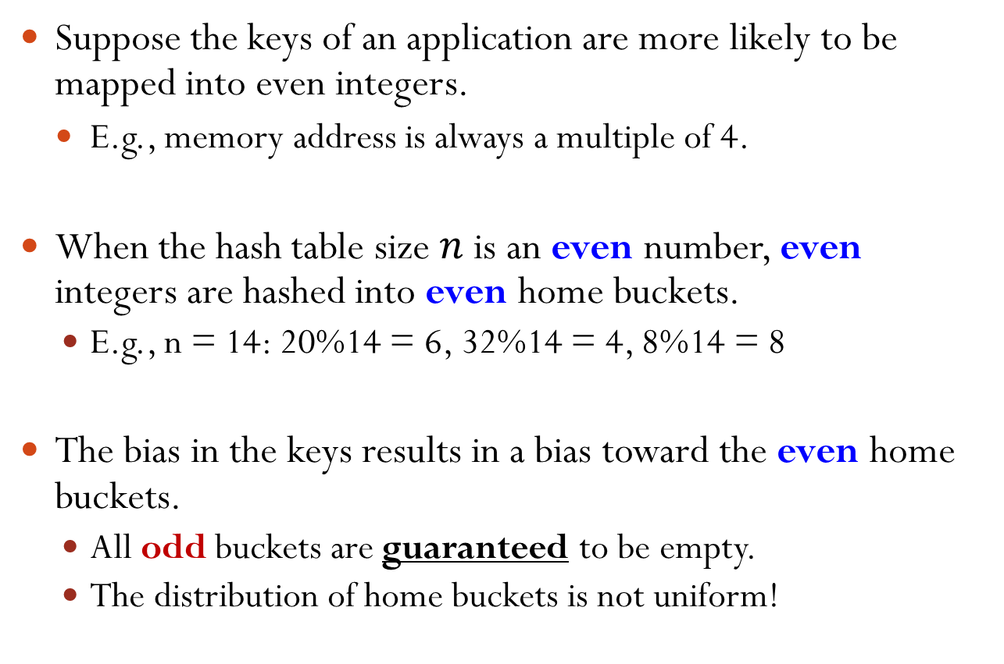
Hashing by Modulo
Suppose the keys of an application are more likely to be mapped into even integers.
E.g., memory address is always a multiple of 4.
When the hash table size $n$ is an even number, even integers are hashed into even home buckets.
E.g., n = 14: 20%14 = 6, 32%14 = 4, 8%14 = 8
The bias in the keys results in a bias toward the even home buckets.
All odd buckets are guaranteed to be empty.
The distribution of home buckets is not uniform!

Slide 26
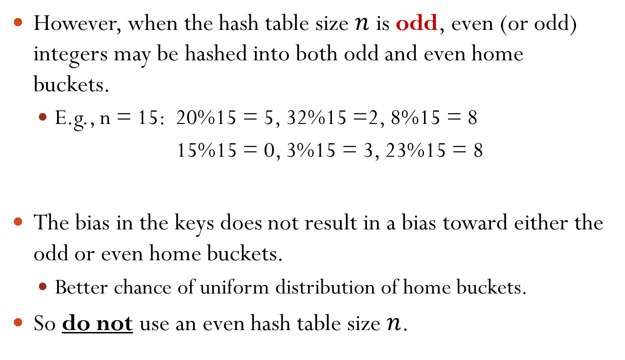
Hashing by Modulo
However, when the hash table size $n$ is odd, even (or odd) integers may be hashed into both odd and even home buckets.
E.g., n = 15: 20%15 = 5, 32%15 =2, 8%15 = 8
15%15 = 0, 3%15 = 3, 23%15 = 8
The bias in the keys does not result in a bias toward either the odd or even home buckets.
Better chance of uniform distribution of home buckets.
So do not use an even hash table size $n$.

Slide 27
Hashing by Modulo
Similar biased distribution of home buckets happens in practice when the hash table size $n$ is a multiple of small prime numbers.
The effect of each prime divisor $p$ of $n$ decreases as $p$ gets larger.
Ideally, choose the hash table size $n$ as a large prime number.
Notes:
If n is a multiple of 3 and the keys are multiple of 3, then only the 3k slot will be occupied.
As p becomes large, it is less likely that the keys%p gets biased.

